Slide 1


Slide 2


AN INVESTMENT STRATEGY
THAT GIVES YOU
THE BEST OF BOTH WORLDS
Grow Your Money with us...
Technically & fundamentally

Slide 3



UNDERLYNING PRINCIPAL
MARKET REWARDS GROWTH
GOOD COMPANY V/S GOOD STOCK
OPPARTUNITY COST

Slide 4

MARKET REWARDS GROWTH
Stock A
Price: 100
EPS: 10
P/E: 10
Growth rate: 8%
Peg ratio:1.25
Stock B
Price 100
EPS: 5
P/E: 20
Growth rate: 25%
Peg ratio: 0.8
Stock B, though expensive on P/E basis, is likely to give more return due to higher growth

Slide 5
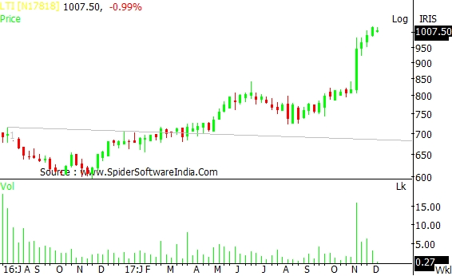
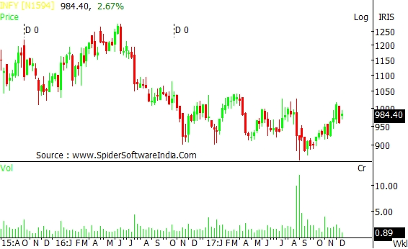
GOOD COMPANY vs GOOD STOCK- OPPORTUNITY COST
L&T INFOTECH (UP 48% YTD)
INFOSYS ( DOWN 2% YTD)
Both are good companies, but L&T Infotech turned out to be a better stock

Slide 6
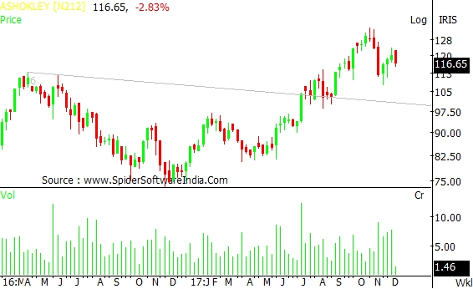
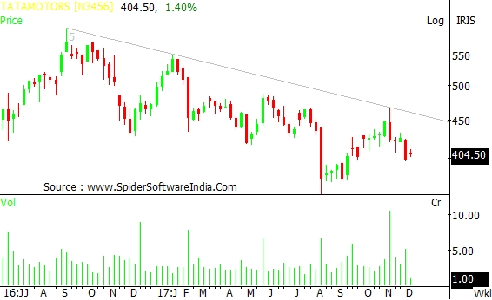
GOOD COMPANY vs GOOD STOCK- OPPORTUNITY COST
ASHOK LEYLAND (UP 46% YTD)
TATA MOTORS ( DOWN 14% YTD)

Slide 7

PRUGROW works on a unique strategy which combines both fundamental and technical analysis to generate superior return compared to index.
The idea is to select a “fundamentally sound stock” which is also technically bullish i.e. Looking strong on chart.
Better known as TECHNO FUNDA calls

Slide 8




FUNDAMENTAL ASPECTS
Investment in Good Corporate Governed companies
(Avoiding companies having questionable management)
No OR Minimal pledge shares
Decent Return Ratios
(ROCE, RONW)
Positive operating cash flow &
Good earnings growth

Slide 9




TECHNICAL ASPECT – WHY USE CHART
To Avoid a stock when it is in a consolidation mode or downtrend so that price/time loss can be minimised
To Catch a stock when it is has just broken out rather than after it has run up a lot, so that risk-reward is better
Helps choose among many stocks where all the companies might be good but not all the stocks
Works on the principle of “Right Stock at Right Time”

Slide 10
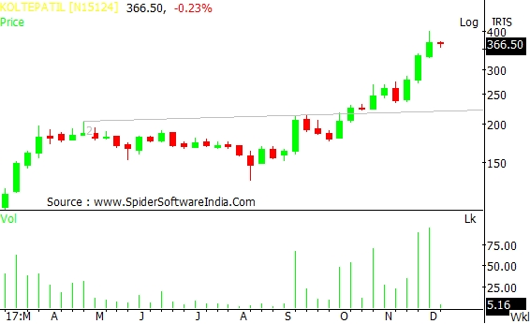
RECENT ONE: KOLTE PATIL: RECO. DATE: 10TH OCT. 2017, RECO PRICE: 220

Slide 11
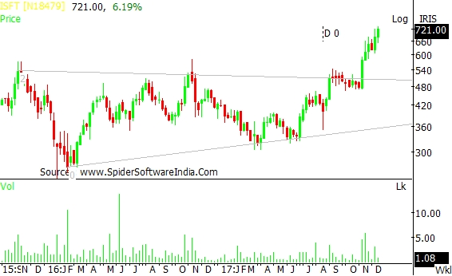
ISFT– RECO. DATE: 30 AUGUST 17, RECO. PRICE: 533

Slide 12

ALL STOCKS DO NOT
GIVE QUICK or
POSITIVE RETURN Therefore…
Build a portfolio of about 20-25 stock
Exit if key technical levels are breached decisively
Pre-decided profit booking levels (20%, 30%, 50%)

Slide 13
PRUGROW vs NIFTY (Since July 2015)

Slide 14
PERFORMANCE OF PRUGROW
(SINCE PRODUCT LAUNCH on 6th JULY 2015)
Date | Index | Stock Value | Ledger balance | Total Value | NAV | NAV Change | Index Change
06-Jul 2015 | 28,208 | 238082 | 764608 | 1002690 | 10.027 | 0.27% | 0
31-Aug-2017 | 31,730.49 | 1240310.95 | 186010.51 | 1426321.46 | 14.263 | 42.63% | 12.48%
31-Jul2017 | 32,514.94 | 1239306.65 | 207818.43 | 1447125.08 | 14.471 | 44.71% | 15.27%
30-Jun -2017 | 30,921.61 | 1221735.05 | 187838.32 | 1409573.37 | 14.096 | 40.96% | 9.62%
04-Dec-2017 | 32870 | 1310789 | 235825 | 1546641 | 15.466 | 54.66% | 16.52%

Slide 15
PERCENTAGE ALLOCATION METHOD
The product follows a percentage allocation method in which new account will replicate the model portfolio in terms of percentage allocated to each stock.
For example, in the model portfolio, stock A and B are having weightage of 5% and 2% respectively, a new account of 5 lac will start with Rs. 25000 in stocks A and Rs 10000 in stock B.
Similarly, a new account of Rs 10 lac will start with Rs. 50000 in stock A and Rs 20000 in stock B.

Slide 16

CAGR
PRUGROW vs MF SCHEMES
PRUGROW 2-YEAR CAGR AS ON 01 DEC, 2017 IS
21.5%
Which is third highest in diversified category and ninth highest in small & mid cap category (source: fundzbazar.com)

Slide 17
DISCLAIMER
This report has been prepared by Prudent Broking Services Pvt. Ltd. for information purposes only. Although this report is based upon sources we believe to be reliable, we do not guarantee its accuracy or completeness. The contents of this report do not indicate or guarantee future investment results. Further, this report is not intended as a solicitation or recommendation with respect to the purchase or sale of any particular investment. This report may not be copied, re-distributed or reproduced in whole or in part without the prior written approval of Prudent Broking Services Pvt. Ltd.

Slide 18


Prudent Broking Services Pvt. Ltd

